Slide 1


Reciprocity

Slide 2
Agenda
What is Reciprocity?
Qualifying for Reciprocity
Participating Reciprocal Systems
How to Establish Reciprocity
Incoming VS. Outgoing
Tier Placement
Key takeaways
Q&A

Slide 3
What is reciprocity?
Reciprocity is a legal agreement between MercedCERA and certain public retirement systems in California. This includes incoming employment to MercedCERA and outgoing employment with another public system. If you meet the criteria, reciprocity allows:
Linked service credit across systems for vesting & retirement eligibility.
Final compensation to be calculated using the highest eligible salary across both systems, subject to plan limits.
Note: You do not “transfer” your contributions. Each system calculates and pays its own portion of your retirement benefit.

Slide 4
Qualifying For Reciprocity
To establish Reciprocity, you must:
Leave MercedCERA-covered employment and leave your contributions on deposit. Which also includes not rolling over your contributions to an IRA.
Begin work & membership with a reciprocal system within 6 months(180 days) following the separation of your MercedCERA-covered employment. *Reach out to the office if you fall into this scenario
Your service in the reciprocal system cannot overlap with your MercedCERA service
Retire from both systems on the same day. *Unless Section 31835.1 of the 1937 Act applies.

Slide 5
Participating reciprocal system
State Systems
• California Public Employees’ Retirement System (CalPERS)
• California State Teachers Retirement System (CalSTRS)
• Judges’ Retirement System I & II (JRS) County Systems
County Systems
Alameda Contra Costa Fresno Imperial Kern Los Angeles Marin Mendocino Orange Sacramento | San Bernadino San Diego San Joaquin San Mateo Santa Barbara Sonoma Stanislaus Tulare Ventura

Slide 6
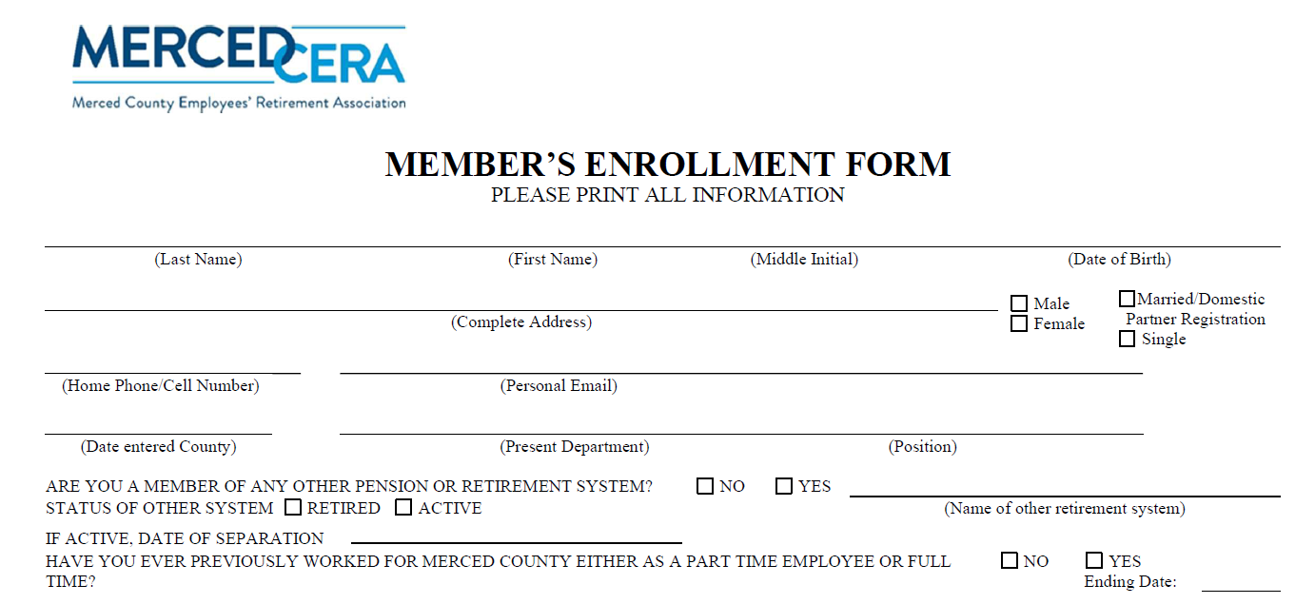
How to establish reciprocity
Contact MercedCERA when accepting new employment to discuss your eligibility.
Let your new retirement system know you are a MercedCERA member.
Confirm your hire date and separation date, careful-timing is critical.
Submit any required forms to both retirement systems.
Once you establish Reciprocity, your election is irrevocable.
Notes:
Must take action with Waiver & Disposition of Contribution form

Slide 7

Incoming VS Outgoing Reciprocity
Incoming Reciprocity applies when you join a new MercedCERA-covered employer that has a reciprocal agreement with another system.
Outgoing Reciprocity applies when you leave a MercedCERA-covered employer and enter a new, eligible public retirement system.

Slide 8
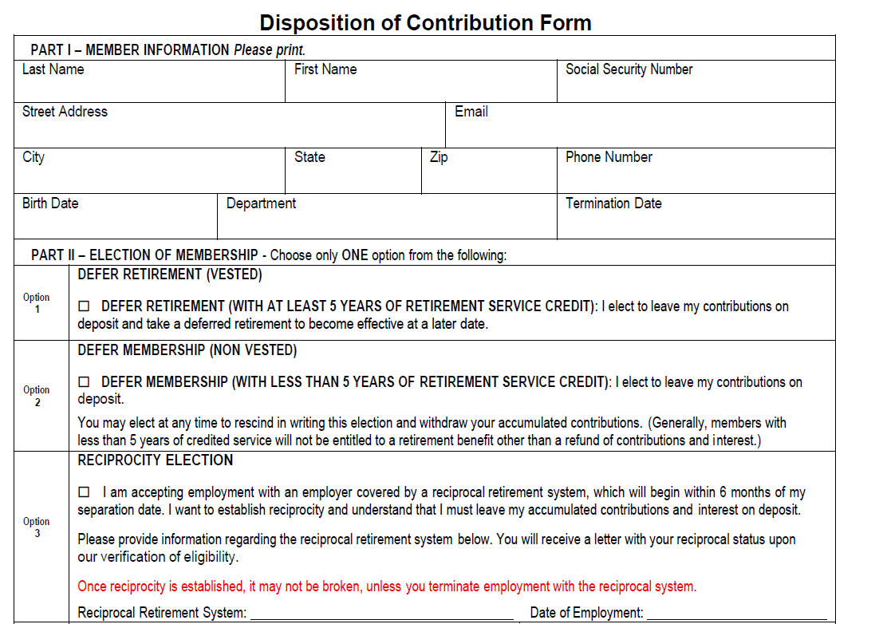
Separation from employment
When an employee separates from employment:
MercedCERA will certify mail a Disposition of Contribution Form to the mailing address on file.
The Disposition of Contribution Form has multiple options for members to select, one of them being the “Reciprocity Election”

Slide 9
Tier Placement
Tier 4 is the only membership open. *Percentage based
Anyone hired after 1/1/2013 who establishes reciprocity will automatically be placed into a Tier 4 membership.
However, if you’re incoming reciprocal and your membership date with the reciprocal system is before 1/1/2013, you will be placed into our Tier 3 membership. *Age based
Ex: Previous system hire date was 1/1/2016 you will be placed as a Tier 4 member.
Previous system hire date was 1/1/2006 you will be placed as a Tier 3 member.

Slide 10
Key takeaways
Is Reciprocity for you?
You must leave membership in the first agency and enter new membership in the new agency within 6 months.
Ex: Your separation date is 7/1/2026 from MercedCERA. You will have to begin employment with the new system within 6 months of that date.
You cannot withdraw your contributions from any reciprocal agency.
You must retire from all reciprocal agencies on the same date. *Unless Section 31835.1 of the 1937 Act applies.

Slide 11
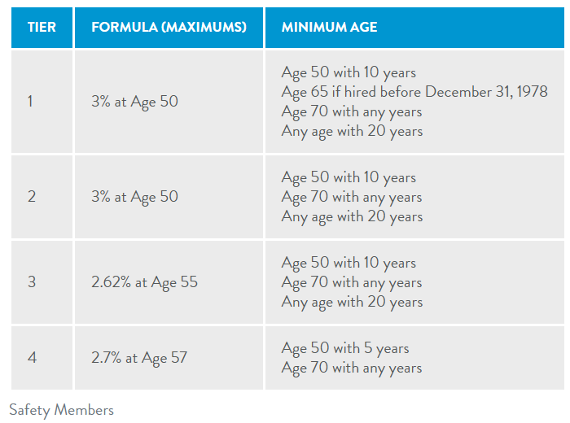
To sum it all up…..
Safety Ex:
Jane Doe is a tier 2 safety member, age of 48 and has completed 15 years of service with StanCERA. Her start date was 7/1/1996. She then entered employment with MercedCERA on 11/12/2011 and completed 5 years of service. Her total years of service is 20 years. This allows her to be eligible to retire from both systems. Jane’s FAC from StanCERA is $5,500 and $6,500 from MercedCERA. We will utilize the higher FAC of $6,500 with her 5 years of service to calculate her pension. StanCERA will use the higher FAC from MercedCERA to calculate her pension based on her 15 years of service there.
StanCERA will remove non-pensionable pay from MercedCERA’s FAC

Slide 12
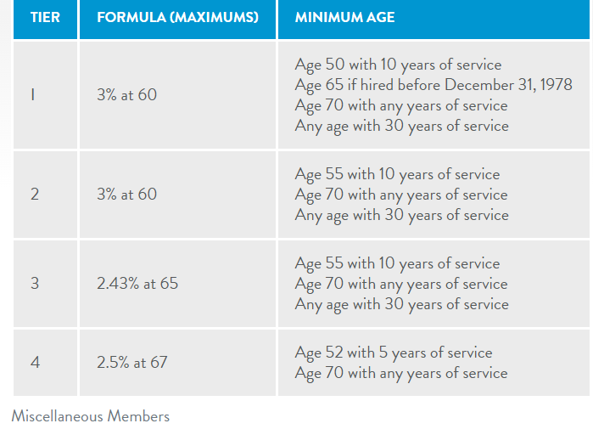
General Ex:
John Doe is a general tier 4 member, age 52 and has completed 4 years of service with MercedCERA. His hire date was 2/1/2016. He then entered employment with CalPERS on 6/1/2020 and completed 1 year of service. His total years of service is 5 years. This allows him to be eligible to retire from both systems. John’s FAC from MercedCERA is $2,500 and $3,500 from CalPERS. We will utilize the higher FAC of $3,500 with his 4 years of service to calculate his pension. CalPERS will use their higher FAC to calculate his pension based on his 1 year of service there.
MercedCERA will remove non-pensionable pay from CalPERS FAC

Slide 13
Questions?

Slide 14
Future sessions from MercedCERA pension education series
Financial Literacy
Learn about the purpose and value of a pension, strategies for managing retirement risks, and common mistakes to avoid when planning for your financial future.
Reciprocity
Understand how service credit and retirement benefits may be affected when moving between eligible public retirement systems.
Community Property
Gain an overview of how pension benefits may be impacted by divorce and community property laws.
Retirement Planning
Explore how your pension works, key retirement considerations, and strategies to help maximize your retirement income.
Death Benefits (Pre- and Post-Retirement)
Learn about the survivor and beneficiary benefits available before and after retirement and the importance of keeping your beneficiary information up to date.

Slide 15

Thank you

