Slide 1
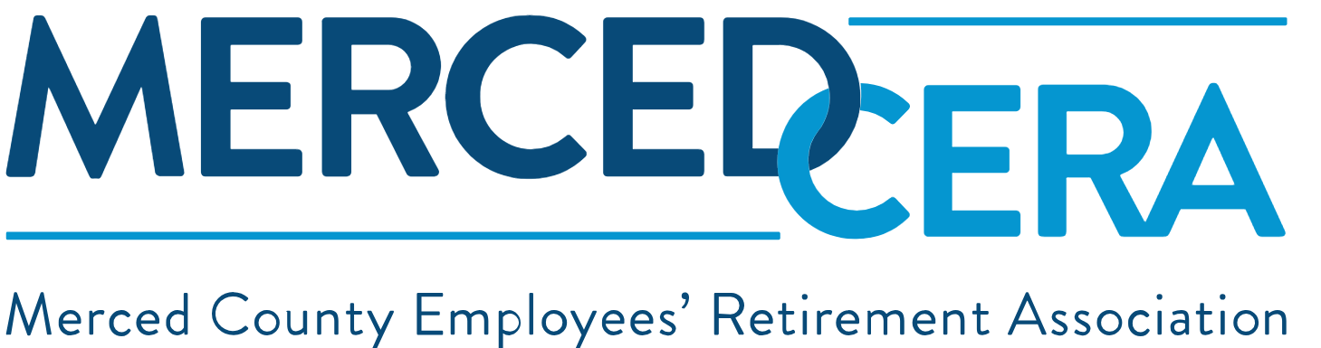

Community Property
This presentation is not legal or financial advice. If you have specific questions to your situation, please contact the MercedCERA office. If you have legal questions, please consult with an attorney or legal aid in your area. MercedCERA shall not be liable for misinterpretation of the information made here.

Slide 2
Agenda
Domestic Relations Order, (DRO) vs Qualified Domestic Relations Order, QDRO)
Community Property Assets vs Separate Assets
Pre-Divorce Planning, Legal Requirements and Key Considerations
Community Property Impact on your Pension – Time Rule Formula
Community Property Summary - Takeaways
Resources
Q&A

Slide 3
Domestic Relations Order, (DRO) vs Qualified Domestic Relations order, (QDRO)
DRO: Is a broad family court order dividing marital assets, such as pensions or child support. The details of division are found in the marital settlement agreement
QDRO: Is a specific type of DRO that applies to private-sector retirement plans following Federal ERISA rules. (Employee Retirement Income Security Act)
Every QDRO starts as a DRO, but not every DRO becomes a QDRO.
MercedCERA uses a specialized form of DRO controlled by MercedCERA plan guidelines and County Employees Retirement Law of 1937, (CERL 1937) including community property specifications.

Slide 4
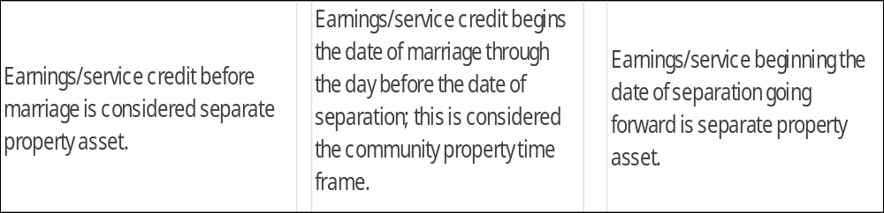
Community property assets vs separate assets
Depending on whether it is included in the recorded DRO, any purchase of service time outside of marriage but purchased with community property monies must be identified in the DRO to be included as community property.
If the marriage date is post-retirement there is generally no community property in the pension, unless court ordered. MercedCERA will comply with court orders.

Slide 5
Pre-divorce planning, legal requirements and key considerations
Important dates to consider, the date marriage began. The date of separation, this terminates the accumulation of community property time.
Joining the pension plan by filing a joinder. The joinder adds the pension plan as a party to the divorce action.
Key considerations:
Community property time frame.
Identifying non-member former spouse, (NMFS) and their current address.
Be sure your DRO addresses survivor benefits, this is crucial to determine if the NMFS is to receive survivor benefits, also if the member dies pre-retirement or post-retirement.
If you have a current spouse, the DRO should address both the NMFS and the current spouse regarding rights to the pension.

Slide 6
Community Property impact on your pension Time Rule Formula
The crucial role of a DRO/QDRO, they are court orders that instruct the pension plan on how to divide pension benefits. Or the court orders 100% interest back to the member of the pension plan.
In community property states like California, pension benefits earned during a marriage are treated as joint property and split evenly (50/50) upon divorce. This division of asset follows the standard Brown Formula.
To calculate the community share: years of marriage service divided by total years of service multiplied by pension benefit amount. Example: 10 years married, employed a total of 20 years total service = 50% of the pension is community property. The ex-spouse gets 50% of that 50%, or 25% of the total monthly benefit.

Slide 7
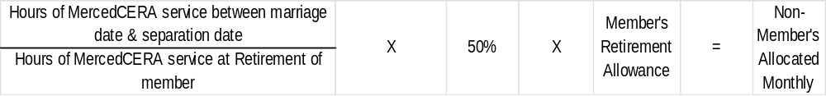
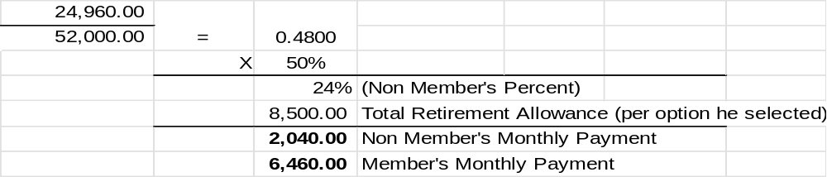
Divorce Finalized – Time Rule Formula
Example:
The married time frame is 12 years, 2080 hours per year equals 24,960 hours.
The members 25 years of service equals 52,000 hours.
The members pension amount is $8,500.

Slide 8
Community property Summary - Takeaways
If you have legal representation, you attorney will file a Joinder with the MercedCERA office.
Public pension (s) is a community asset and should be addressed in the marriage settlement.
Nationwide Deferred Compensation (457b) is a community asset and should be addressed.
Understand your divorce orders that details the division of your pension asset. Do not wait until retirement date to ask questions.
Waiver of Interest: If the NMFS wishes to release their interest after a judgement. The DRO will detail the manner of release either by filing a release with the Superior Courts or notarized letter releasing the community property.
Prior to recording the final DRO, MercedCERA would like to review to ensure the DRO meets the plan requirements.

Slide 9
Resources
Merced County Employees’ Retirement Association website: https://www.mercedcera.com/ Forms & Resources / Employee Member Handbook .
Superior Court of Merced - https://www.merced.courts.ca.gov/self-help/divorce-or-separation.
https://selfhelp.courts.ca.gov/divorce-California.
This division of the asset follows the Brown Formula. The Brown Formula is from the landmark 1976 California Supreme Court case In re Marriage of Brown, it strictly applies to apportioning pensions and some deferred compensation accounts. Case citation 15 Cal. 3d 838 (or 126 Cal. Rptr. 633, 544 P.2d 561). Decided January 27, 1976.
This presentation is not legal or financial advice. If you have specific questions to your situation, please contact the MercedCERA office. If you have legal questions, please consult with an attorney or legal aid in your area. MercedCERA shall not be liable for misinterpretation of the information presented to you.

Slide 10
Questions?

Slide 11
Future sessions from MercedCERA pension education series
Community Property
Gain an overview of how pension benefits may be impacted by divorce and community property laws.
Retirement Planning
Explore how your pension works, key retirement considerations, and strategies to help maximize your retirement income.
Death Benefits (Pre- and Post-Retirement)
Learn about the survivor and beneficiary benefits available before and after retirement and the importance of keeping your beneficiary information up to date.

Slide 12
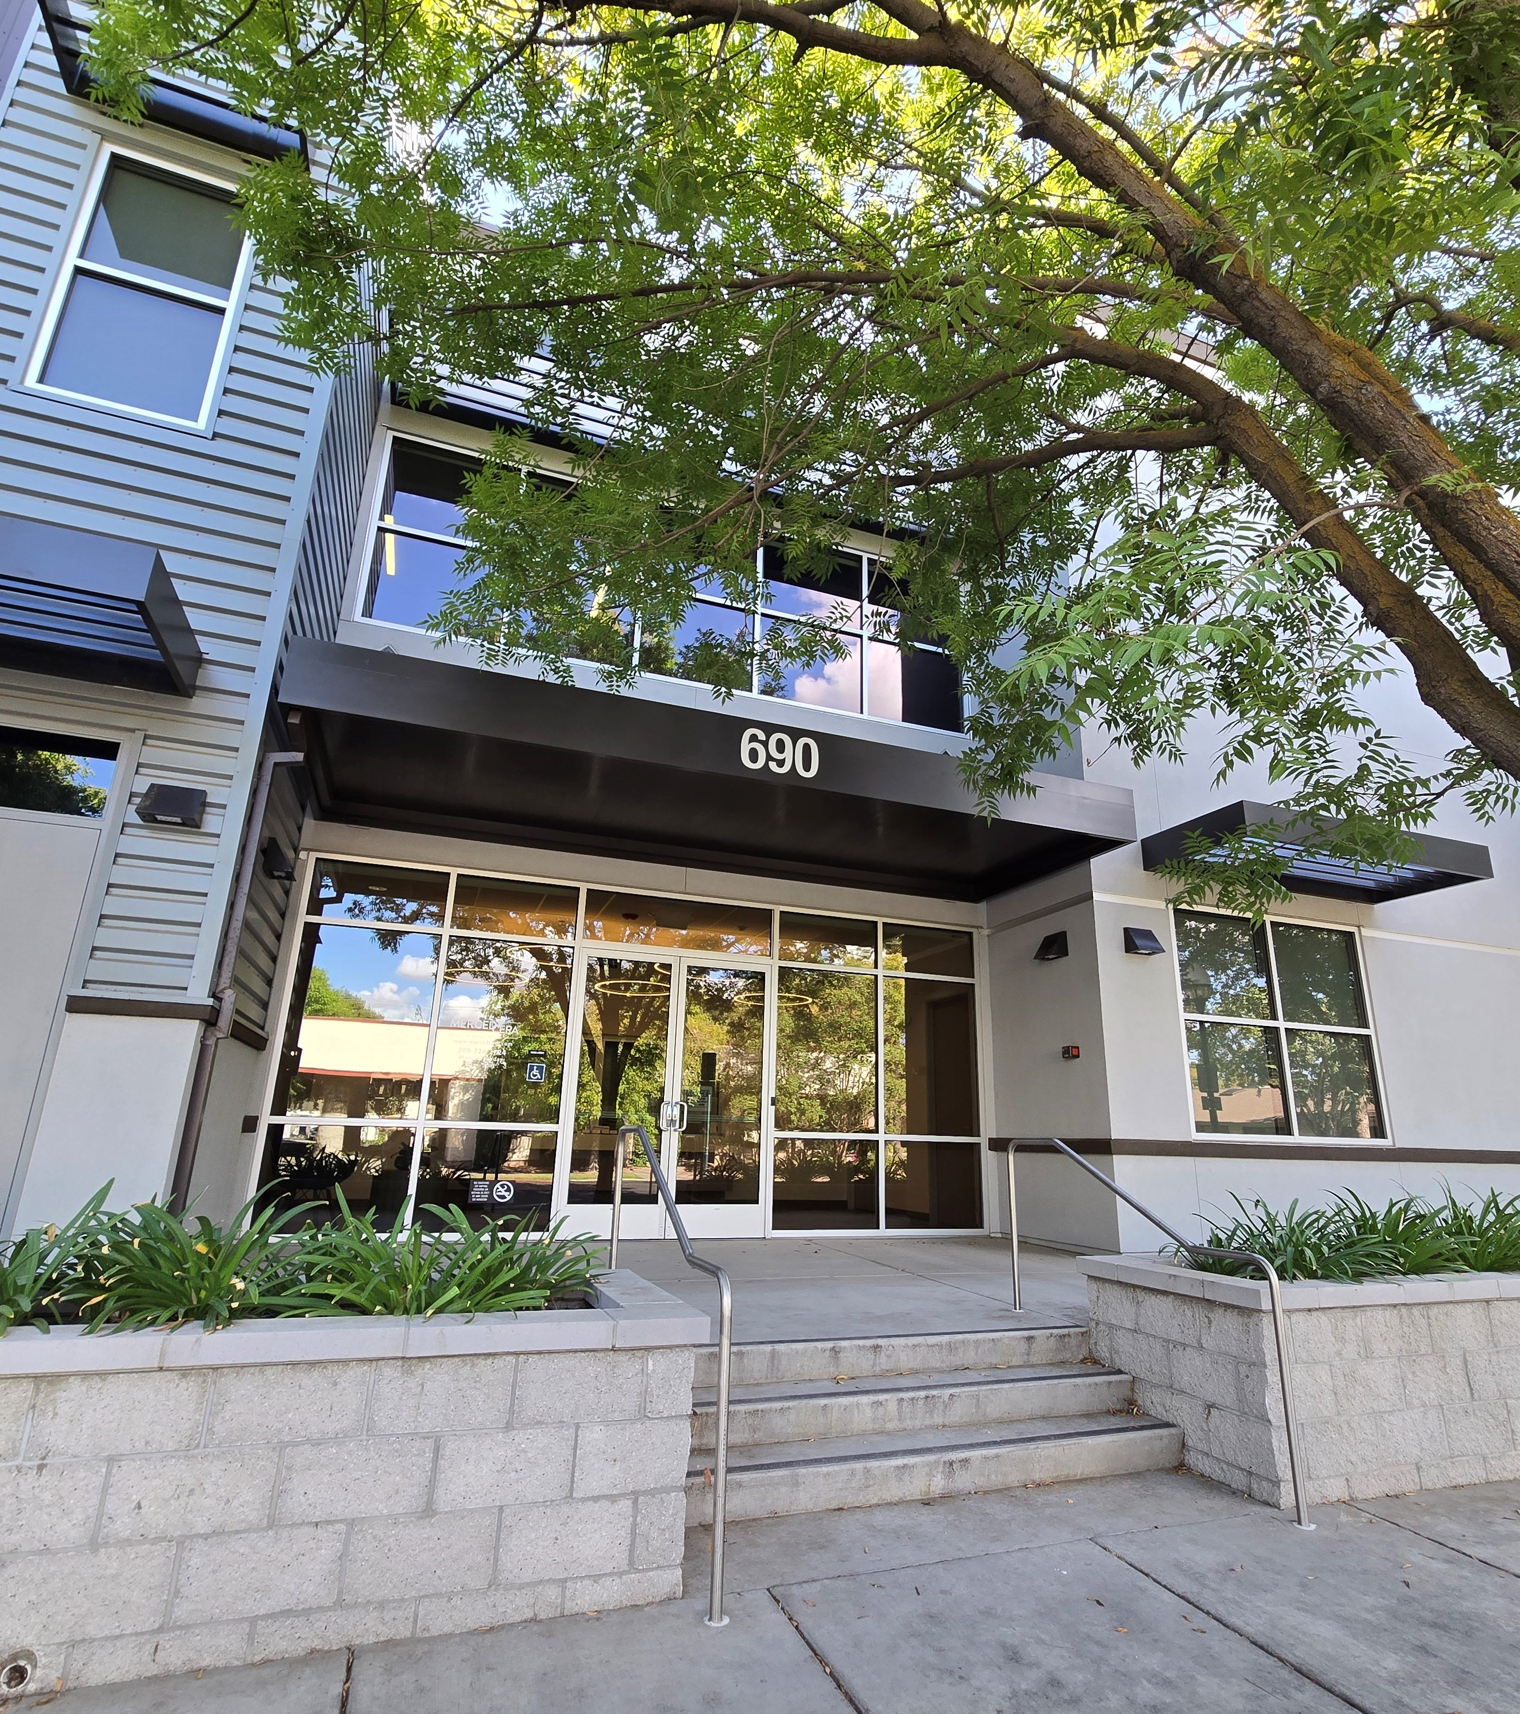
Thank you

